Slide 1


VMAX 10K Enterprise Class for the Growing Mid-Market Customer
Bill Leslie – Corporate Systems Engineer for Partners and Solutions
November 28, 2012

Slide 2
Agenda/Objective
New Symmetrix VMAX 10K and the Enginuity 5876 Q4 2012 SR Operating release
  Compete stronger in the Mid-Market space
Fulfilling promises we communicated at EMC Global Partner Summit
  Easier to provide customer showcases with canned virtual demo guides and vLabs, and
  Easier to get educated with new 10K Advanced Consolidated courseware
How to Win against HP 3PAR

Slide 3

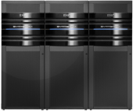

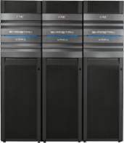





A Comprehensive Portfolio to Meet Customer Needs
VMAX 20K, 40K
VMAX 10K
Trusted. Smart. Powerful.
SCALABILITY
VNX
Trusted. Smart. Efficient.
VNXe
Simple. Efficient. Powerful.
Simple. Efficient. Affordable.
PERFORMANCE/AVAILABILITY
Notes:
EMC has a very complete storage portfolio, and it’s grown even stronger now with the new VMAX 10, 20 and 40K series. The VNX and VNXe family of products provide customers with a solution for Unified file and block, with a scale-up architecture that is flexible and optimized for price and performance. VMAX 10K provides an entry point into the high end Symmetrix family, delivering a highly available, scale-out architecture for consolidation and simplified management of a storage environment. VMAX still sits at the top for advanced, large-scale consolidation, and to serve the maximum performance requirements, in both open systems and IBM System z mainframe and IBM i environments.
The Symmetrix VMAX 10K is the ideal entry-point into the VMAX family delivering multi-controller performance, scale, and efficiency for cost-effective application consolidation in virtual environments.
Brings enterprise to the mid-market. Reliability, performance, scale-out for the mid-market enterprise.
VMAX 10K Market Size ~$8B growing almost 10% CAGR.

Slide 4



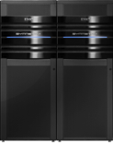
EMC Enterprise Storage Solutions
Maximize your IT data center resources with EMC
Dual Controller
1- 4 Engines
1- 8 Engines
Array Specifications
1,000 drives
1 Engine = 2 Storage Processors
Business Requirements
I/O and B/W price/ performance
Unified file and block
Ease of use is very important
Array Specifications
1,560 drives
4 Engines = 8 Directors
Business Requirements
Multi-controller architecture
Enterprise reliability, availability, and serviceability
Ease of use is important
Scale up and scale out
Array Specifications
3,200 drives
8 Engines = 16 Directors
Business Requirements
Ultimate scale, capacity, and performance
Manual and Virtual Provisioning
Encryption and compression
Mainframe and iSeries
Notes:
With so many options, let’s now take a more prescriptive look at choosing among VNX, VMAX 10K, and EMC’s highest-end storage, the Symmetrix VMAX 20K/40K as shown here as an example.
VNX is the primary unified option, offering a Dual Controller with capacity scaling up to 1,000 drives. VNX offers the most cost-effective solution for capacity scale. VNX should be considered when you are seeking a price and performance benefits for I/O and bandwidth, an integrated file and block solution, and where ease of use is required along with full multi-site replication.
When the highest levels of scale, capacity, availability and high performance levels are essential, IBM Mainframe and iSeries may be needed and full replication and high customization are required, Symmetrix VMAX 20K or 40K are the most appropriate choice. VMAX 40K offers up to eight Engines and 3,200 drives, providing support for mainframe and IBM iSeries. The Symmetrix VMAX 40K is EMC’s most customizable solution with the highest scaling capabilities, performance, and feature sets.
VMAX 10K is nicely positioned between VNX and the VMAX 20K and VMAX 40K in terms of controller scalability. VMAX 10K comes with the Advanced Software Suite with the key software capabilities that provide most customers the software applications that are needed in today’s data center. VMAX 10K is ideal for high-end, midtier enterprises looking for more than a dual-controller solution, yet with a more affordable entry price than VMAX. VMAX 10K is custom designed, packaged, and priced for FAST-optimized drive mixes, and RecoverPoint is the primary replication offering with SRDF for those familiar with SRDF technology. For companies moving up to Symmetrix-class reliability, availability, and serviceability who require NAS file support, VMAX 10K supports a VNX gateway and can easily be attached to VMAX 10K delivering a unified file and block storage solution.

Slide 5






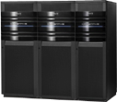


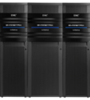

VMAX 10K Enterprise Class with
Mid-Market Affordability
More Than 20 Years Running the World’s Most Critical Applications
1988
1990
1994
2000
2003
2005
2009
2011
2012
New
Symmetrix
4000
Symmetrix
5500
Symmetrix
3000/5000
Symmetrix
8000
Symmetrix
DMX-1, -2
Symmetrix
DMX-3, -4
Symmetrix
VMAX 20K
Symmetrix
VMAX 10K
Symmetrix
VMAX 40K
Symmetrix
VMAX 10K
VM and z/OS
integration,
DARE,
FAST VP,
Federated Live Migration
Efficient:
FAST VP,
FLM,
100% VP, RecoverPoint Splitter
2X performance and scale
Dense Configuration Option
System Bay Dispersion
Federated Tiered Storage
FAST VP for System z
and IBM i
RecoverPoint Splitter
Faster performance
D@RE
FTS
2.5” drives
Drive mixing
Third-party rack
SRDF
Consistency Groups
AutoSwap,
SRDF over Fibre Channel
Concurrent SRDF,
SRDF/Star, GDDR
Secure Erase,
Audit,
Service
ICDA,
RAID, NDU
TimeFinder,
PowerPath
Powerful.
Trusted.
Efficient.
Smart.
Notes:
Note to Presenter: View in Slide Show Mode for animation.
EMC identified an opportunity to bring the most Trusted. Powerful. And Smart. Symmetrix portfolio to a broader set of customers. Many of those customers were experiencing radical data growth, looking for ways to bridge into enterprise class feature and functionality, but we not ready to make the leap to the perceived complexities of the Symmetrix product line.
EMC made the decision to bring the Symmetrix into the mid-market. Offering compelling enterprise class feature functionality at a much more desireable price point, with less complexity of the 20 and 40K. The VMAX 10K is built on the best legacy in the market, with over 20 years of engineering and market leadership.

Slide 6




Why Symmetrix VMAX 10K?
Trusted
  Enterprise-class availability, data integrity, and security
Smart
  Self-tuning and optimized for virtual computing
Efficient
  Simple and cost-effective operations
Notes:
Symmetrix VMAX 10K is…
Trusted:
Symmetrix has over 20 years of industry leadership running mission-critical applications
EMC’s world-class Symmetrix Virtual Matrix Architecture
#1 globally in the high end
Smart:
Optimized for failure-mode performance
Fast VP automated storage tiering
End-to-end management that is simple, intuitive, and quick
Efficient:
100% virtually provisioned
Integrated local or remote replication capabilities
Eco- and IT budget-friendly, energy-efficient power management
Supports both 2.5” and 3.5” drives for the most efficient configurations
Same day install and start-up operation

Slide 7
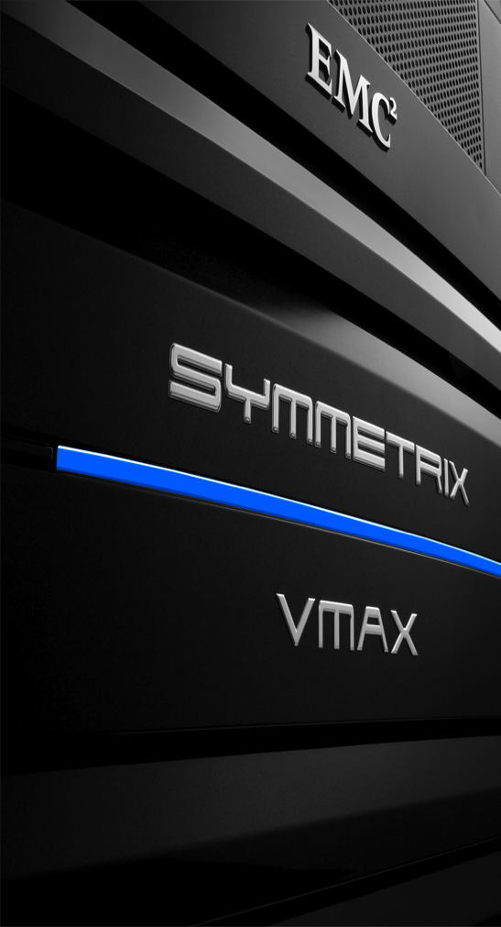
New Symmetrix VMAX 10K and the Enginuity 5876 Q4 2012 SR Operating System

Slide 8
VMAX 10K Announcement Summary
2x Faster, 15+ New Features, Same Great Price
Consolidate Tier 2 SAN
  Simplify management
  Improve scalability and availability
  Lower TCO
More accessible to midsize enterprises
EMC extends Tier 1 VMware leadership
Virtualize critical applications
Announcement Article
Notes:
EMC made the decision to be available to our partners in advance of formal customer announce. We did this because you our partners are driving 70% of business. Your success is driving our success. We also recognize that this is a very large addressable market, expected to reach $9B in customer revenue according to IDC, and growing at almost 10%.
The new VMAX 10K is orderable today in CX.
Let’s take a look at some of the high level features in this release.
Performance is now twice as fast as the original VMAX 10K (VMAXe) product.
We have added over 15 new features in this release.
All at the same great price. Some cases <10% price increase.
All this continues to reinforce the positioning of the product. It is ideal for consolidation of Tier 2 SAN. With easy management, using Unisphere. The new price performance characteristics make is even more appealing for mid-tier enterprises looking for enterprise class feature/functionality for their storage. When you hear customers speaking of scale-out and virtualization of critical apps, this is an ideal time to bring up the VMAX 10K.

Slide 9
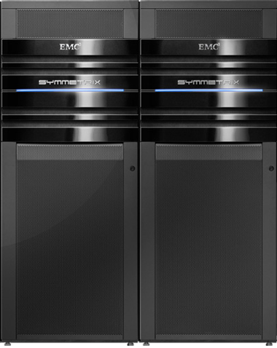
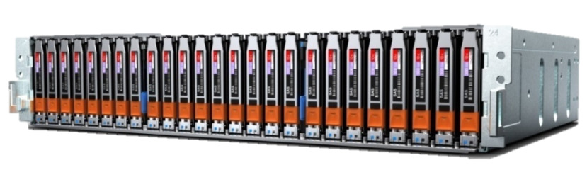
VMAX 10K Gets Faster, New Features
Mission Critical Design With Tier 1 RAS at Tier 2 Prices
Increase leadership over mid-tier
  Consolidate Tier 2 storage: HP 3PAR, IBM XIV, NetApp C-mode
  VMAX 10K growth: >500% YoY revenue growth in Q2 2012
VMAX 10K up to 2x Faster
  Faster CPUs and 50% more cores
VMAX 10K Enhancements
  Data @ Rest Encryption, FTS, and 44% more total spindles
  2.5” drives: 2x disks/tile, reduce power/weight by 1/3rd
FAST
Customer Benefits
  Supports multiple critical business applications simultaneously
Consolidate and replace Tier 2 vendors
Notes:
On October 4th EMC released a faster EMC Symmetrix VMAX 10K with new features to help you win more deals against mid-tier, multi-node competition.
VMAX 10K now has faster CPUs with 50% more cores to support more virtual and physical workloads on one system. It adds data at rest encryption, dense 2.5” drive, and Federated Tiered Storage support, and also supports 3rd party racks to provide maximum flexibility, efficiency, and data security. New software bundles simplify selling and align with similar bundles on the VMAX 20K and 40K.
This makes VMAX 10K more competitive against Tier 2 multi-node competitors including HP 3PAR, IBM XIV, and NetApp cluster-mode for SAN. The VMAX 10K is also competitive against smaller IBM DS8000 and Hitachi VSP configurations when price is the customer’s top concern.

Slide 10
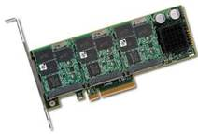
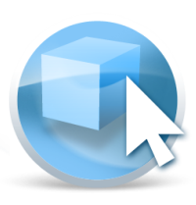
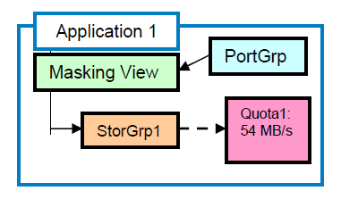
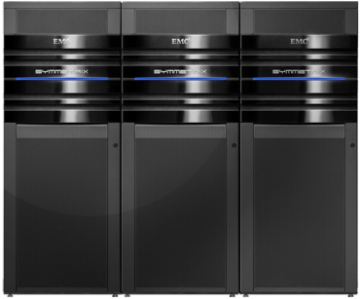
More than 15 VMAX Enginuity Enhancements
Enginuity Operating Environment Update Simplify Virtualized Workloads & Cloud
Customer Benefits
Across the board improvements in performance, efficiency and management
Manage everything VMAX and DMX from Unisphere
More flexible storage deployment options
FAST
Thick
Thin
Front End Performance
Host I/O Limits make performance more manageable for multi-tenant and cloud environments
FAST More Efficient
Supports 4th Tier
Compression for inactive data
Flexible Storage
Mix 2.5”/3.5” DAEs
New drives
VMAX 10K in 3rd party rack
Replication
TimeFinder Clone refresh/ restore easier to use
VMAX 10K SRDF near-parity with 20K/40K
Integration & Mgmt
Unisphere for
VMAX 1.5 manages DMX
VAAI UNMAP
VFCache 1.5
*2.5” DAE, and mixed DAE not supported on VMAX 20K or in VMAX 10K sold before October 2012
Notes:
In addition to the refreshed VMAX 10K, EMC also announces new software for all VMAX platforms in the Enginuity 5876 Q4 2012 Service Release.
This Enginuity update brings more than fifteen new features and certifications to the VMAX family with across-the-board improvements in performance, efficiency, and management.
VMAX includes a new feature called Host I/O Limits to manage performance in multi-tenancy environments. FAST is even more efficient, while TimeFinder and SRDF enhancements make it easier to use clones for test and dev and to replicate data between different VMAX models.
New customers of the VMAX 10K and 40K also have new more flexible deployment options including the ability to mix dense 2.5” and high-capacity 3.5” drives, giving them the best combination of performance, capacity, and efficiency in one system.
EMC continues to enhance VMAX to maintain our leadership in Tier 1 storage

Slide 11
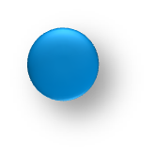





Additional VMAX Enhancements
4 Tiers for FAST VP with Federated Tiered Storage and compression
TimeFinder/VP Snap
off of R2
New
Flash
Time Finder/VP
Snap
Fibre Channel
>2:1 compression
SRDF/A
SATA/SAS
Time Finder/ VP
Snap
SRDF/A
FTS
Real-time analysis provides continuous optimization
Notes:
A capability that is new with Enginuity 5876 Q4 2012 SR is that if one of the FAST VP tiers is Federated Tiered Storage, then you can have four tiers. This allows you to have three drive types and Federated Tiered Storage in the same FAST VP group. Also you can compress inactive data and receive an average of 50 percent compression rate (capacity savings) for that inactive date. These compression rates and the age of the data can be set through Unisphere for VMAX.
Concurrent SRDF/A, which allows a single source to be simultaneously replicated to two separate target volumes asynchronously over any distance, can be combined with the ability to support a TimeFinder/VP off an SRDF/A target device. Also new is support for TimeFinder/VP Snap off SRDF/A R2 in SRDF multi-site topologies, including SRDF/Star that lets the user create local copies of the SRDF devices on the primary system and local copies of their SRDF partner devices on the secondary system. Having the capability of doing virtually provisioned snapshots gives customers better storage and cache efficiency on their R2 devices.

Slide 12
Target Customer Audiences
Business decision makers from midmarket customers requiring mission-critical storage.
Technical decision makers from midmarket customers considering new multi-node storage systems
Existing EMC VNX/CLARiiON customers considering consolidation to non-EMC platforms
Existing Symmetrix VMAX & DMX customers considering tech refreshes

Slide 13

VMAX 10K Solves Customer Pain Points
Customer pain points
VMAX 10K delivers…
Downtime
Enterprise reliability, availability, serviceability
Growth
Scale-out
Unpredictable SLAs
Multi-controller
Budget
Price
Notes:
Symmetrix VMAX 10K is designed to address a very wide segment of companies with specific pain points. If you are looking to achieve enterprise-class reliability, availability, and serviceability; want the ability to scale out performance as you scale up your storage; require a storage solution that is simpler to operate, manage, and provision; and want a multi-controller solution that delivers failure-mode performance at a reduced price point, Symmetrix VMAX 10K is an ideal fit for you.

Slide 14
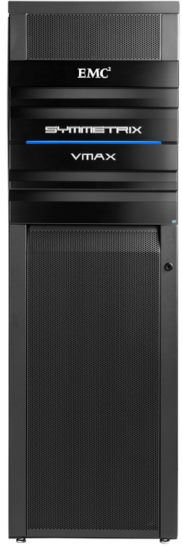
Top 5 VMAX Plays
Why do customers buy a VMAX?
Data availability and integrity
Data center consolidation to lower Opex and Capex costs
Advanced features that enable a reduction in capex and opex costs
  FASTVP
  FTS
Performance at scale and during array faults
Data Protection and security
  SRDF, D@RE

Slide 15
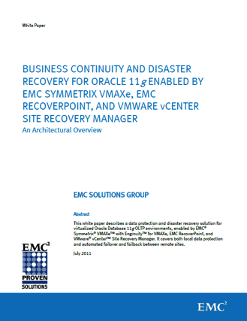
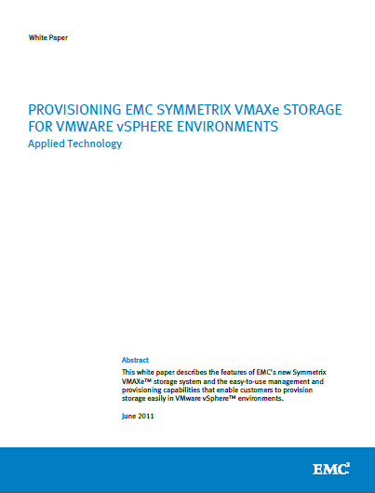
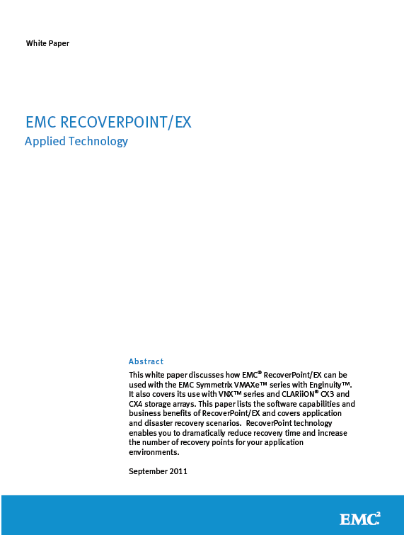
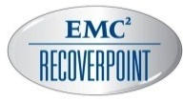


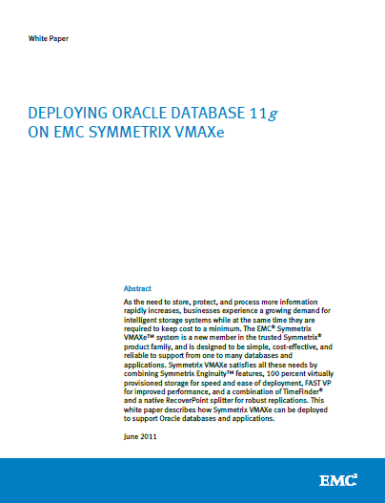
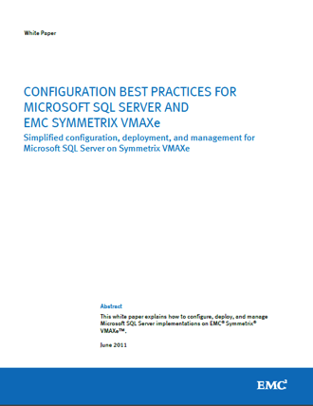
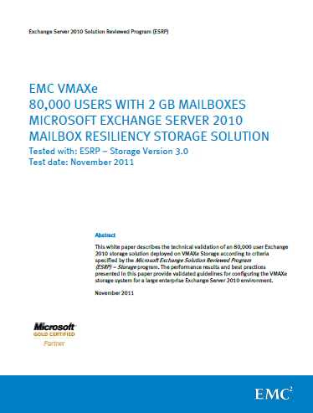
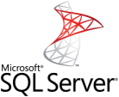
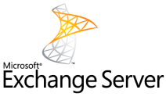

VMAX 10K Solutions “How To” Library
Notes:
For companies new to Symmetrix or VMAX technology, EMC provides an extensive list of technical resource documents to help you get started. Besides the traditional user and technical guides, EMC’s Proven Solutions and technical writers provide you with real-world deployment and implementation white papers. Many of these can be found on EMC.COM or EMC’s Powerlink, which is EMC’s global interface of knowledge sharing among EMC, its partners, and its customers.
Additional slides will be made available in the deck that is posted.

Slide 16
Easier to Sell
Notes:
At Global Partner Summit, we told you we were looking to make it easier to sell, understand, compete and win with VMAX 10K. Let’s take a few minutes to look at some of the ways we are making things easier for you.

Slide 17
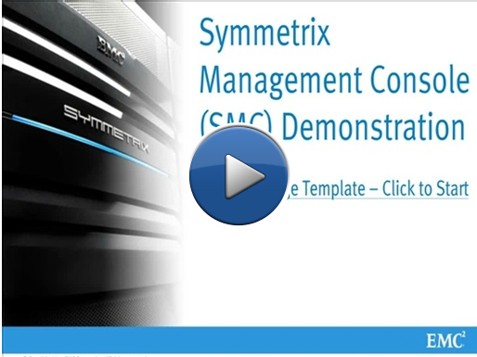
Demo, Demo, Demo
http://www.emcdemocenter.com/
Leverage Demo’s to Highlight EMC’s Simplicity
Provisioning New Hosts to VMAX 10K
Creating VMAX 10K Storage Templates
VMAX 10K Performance Analyzer
VMAX 10K FAST Dashboard
VMAX 10K Performance Heatmaps
VMAX 10K SMC Dashboard View
VMAX 10K Expand Storage Wizard
Notes:
EMC has many video demonstrations, whiteboards, etc on a wide variety of topics and solutions to help you prepare for conversations with your customers. These demo are meant to enhance your training in specific topic areas and assist in sales cycles, increasing the likelihood of successful customer interactions.

Slide 18

EMC Partners: vLab
  Partners account for 12% of vLab users since Feb, 2012
Open to all Velocity Partners
You have access to all that EMC does
https://vlab.demoemc.com
Velocity team validates approvals
“EMC vLabs are simply amazing. Bravo. What a killer investment they have made in their partners.”
Large EMC VAR
Notes:
Opened to partners in February.. Usage continues to grow

Slide 19
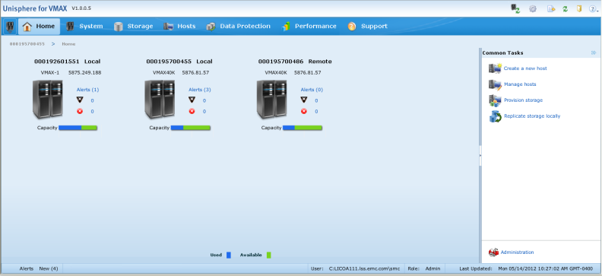
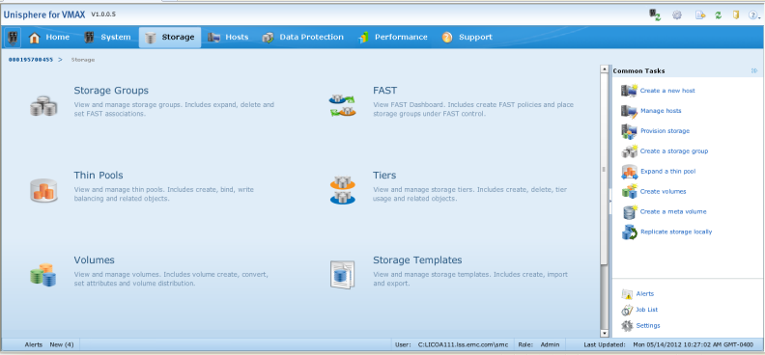
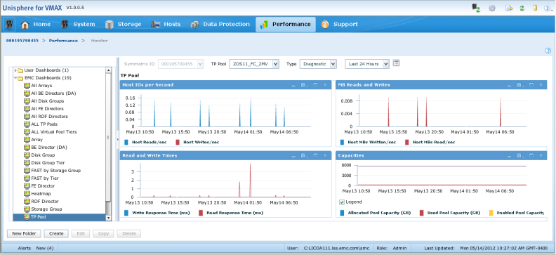
Unisphere for Symmetrix VMAX
Management modernization
EMC-standard look and feel
Contextual, simple
to navigate
vLab Available
Now!
Easily provision, manage, and monitor
Notes:
EMC Unisphere for the Symmetrix VMAX family fully replaces Symmetrix Management Console and Symmetrix Performance Analyzer. Unisphere for VMAX 1.5 supports all the new Enginuity 5876 functionality. The legacy Symmetrix functionality is supported with Symmetrix Management Console 7.3.3 and Symmetrix Performance Analyzer 2.2.3 which are included. Unisphere and SPA recognize and honor the SMC eLicense.
Note to Presenter: Click now in Slide Show mode for animation.
Unisphere for VMAX uses the same framework as the VNX family, and it provides users with the same EMC-standard look and feel.
Note to Presenter: Click now in Slide Show mode for animation.
Unisphere for VMAX is contextual and simple to navigate when compared to Symmetrix Management Console and Symmetrix Performance Analyzer.
Note to Presenter: Click now in Slide Show mode for animation.
With Unisphere, users can easily and rapidly provision, manage, and monitor Symmetrix VMAX arrays.

Slide 20
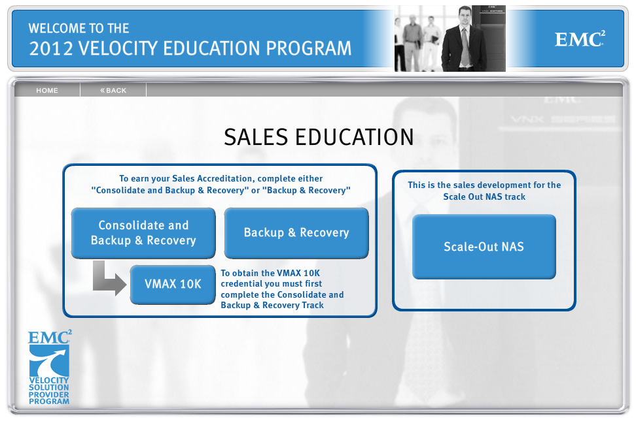
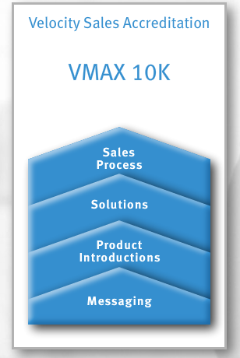
New VMAX 10K Accreditation
Faster than ever… Under 3 hours
Notes:
We have also made it easier for you to sell VMAX 10K. We have reduced the time requirements significantly for sales and SE level accreditation for the VMAX 10K. Now, in about 3 hours you can take the course and start selling into higher end mid-tier deals.

Slide 21
Winning vs..
HP 3PAR
Notes:
Let’s take a look at how you can compete and win vs.. HP 3PAR.

Slide 22
HP Product Lineup
General Purpose
Virtualization
EMC Competitive
Large Enterprise/ Fed
P10000 (3PAR)
VMAX
P9500 (mainframe)
VMAX 10K
Cloud Hosting Services
VNX
Corporate
P6000 (EVA)
Mid-Size
P4000 (LHN)
VNXe
Small, Remote Office
P2000 (MSA)
IOmega
Notes:
How do HP Storage array products line up with EMC products?
In the high end enterprise market HP offers both 3PAR and OEM’d P9500 from Hitachi. Note: P9500 is positioned when mainframe connectivity and complex remote replication is required.
3PAR’s new V Class is called the P10000. It competes with VMAX 10K or VNX depending on the requirements of the customer. Most 3PAR installations are sold as 2 node systems and it is recommended that Sales position a VNX initially. Unless the requirements clearly warrant a VMAX 10K position VNX by default.
In the mid-range HP offers the F-200/400 3PAR and the EVA P6000. The P6000 (EVA) was announced in July of 2011 with features falling far behind the VNX. HP is currently offers F Class arrays at substantial discounts eluding to an eventual EOL for EVA.
HP also offers the P4000 (LeftHand Networks) for the low-end of the mid-range competing with VNXe. The P4000 is a single controller that overcomes the problem of a single point of failure by doing RAID over a LAN to a second P4000. This makes its raw capacity very inefficient.
Lastly, for small and remote offices, HP offers the P2000 (MSA). This low-end product is positioned against IOmega products.

Slide 23
Attack HP’s EVA and XP Accounts
HP likely is trusted advisor where HP servers sold
Target EVAs (HP Sales told to lead with EVA P6000)
  Emphasize Unified storage
  Beware: If you fight EVA and win, HP will counter with 3PAR
    Preempt this situation by revealing to customer what HP will do
Attack XP (and P9500) accounts now with VMAX 10K
  XP customers being migrated to 3PAR
  Emphasize remote replication and CDP
Know your enemy
  Know how many nodes 3PAR is really proposing
Notes:
You will have an uphill battle with customers who currently use HP servers and HP is their trusted advisor. Also, HP has an enormous installed base of EVAs. And these EVAs are vulnerable because the EVA has lagged behind the midrange storage industry, especially behind CX4 and now VNX. HP released in July, 2012, perhaps the last EVA called the P6000. HP would love to migrate these customers to 3PAR but they don’t want to open these gates too far for fear of losing them to EMC or others. Now is the time to show EVA customers just how far behind the industry they are – show them auto-tiering with flash for example. Be aware that if you do defeat HP’s EVA P6000, at that point HP will switch the fight to their 3PAR. Preempt this tactic; reveal ahead of time that this is what HP will attempt to do.
(Note on install base- There are roughly 11,000 EVA 6000/8000 series boxes that HP is trying to convert to 3PAR. This is prime target opportunity to covert to EMC. HP will require forktruck replacement to 3PAR.)
HP is moving XP customers who do not need to support mainframes to 3PAR as fast as they can. These customers will be very interested in VMAX 10K or VNX with unified storage. Emphasize RecoverPoint with continuous data protection to help you win.
And remember that typically HP will be proposing a dual-node 3PAR system. Take advantage of its weaknesses.

Slide 24
How To Win: Key Takeaways
Lead with VNX; upsell to VMAX 10K if needed
Virtually impossible to downsell from VMAX 10K to VNX
Demo, Demo, Demo
Customer will not listen to ease of use until they see it
Attack EVA and XP accounts NOW
HP will push these customers toward 3PAR. Have them migrate to EMC instead
Notes:
We have listed 3 Key Takeaways that you need to leave this session with.
Always lead with VNX, If you need to you can up sell from VNX to VMAX 10K but if you start with VMAX 10K, it is virtually impossible to down sell to VNX.
Next, is demo, demo, demo Unisphere or if you are selling VMAX 10K; SMC. Always demo Tier Advisor, no other vendor has a tool for auto tiering – it will blow your customers away. In many cases, show the customer who has EVA the analysis from Mitrend.
3PAR pushes the fact that they are easy to use and they are easy. But EMC does not lag behind. Show how Unisphere makes our products as easy as 3PAR. Be first to show the customer a demo, establish EMC as the ease-of-use standard, then they will listen to you with interest.
Third, you need to attack EVA and XP accounts now. HP intends to migrate eventually all the EVA and XP accounts to 3PAR. These customers have to suffer the pain of a migration to a different platform and architecture, so they might as well migrate to the industry’s best, that is to EMC products.

Slide 25
Avoid these traps vs. 3PAR - Hardware
#1
“They sell multi-controller, I need to match that in order to win – I’m bidding VMAX”
3PAR: 65% of arrays are sold 2-node, most cases VNX is the best comparison, then VMAX 10K. P10000 is price-optimized against VMAX, focus on VNX and VMAX 10K to win.
#2
“It’s okay that 3PAR was there first, I’ll just sell the customer on EMC’s superiority afterwards”
3PAR: Will get the customer to force you to bid VMAX, then work your way down. It is VERY difficult to go from VMAX to VMAX 10K to VNX
#3
“I’ll match 3PAR’s all FC disk configuration and avoid expensive flash”
EMC is optimized for flash – get auto-tiering to be a requirement. 3PAR’s cost to license SW on flash although reduced in Q4 2011 remains expensive. 3PAR’s auto-tiering can slow performance.
#4
“3PAR is going to bid its latest and greatest product, the V-xxx”
3PAR: Will still bid the T Class (n-1) in a price sensitive situation. Although drives are the same cost, V Class HW has 85% and SW has a 16% price premiums. F Class has $69K special for midrange.
#5
“I think our 450GB and 1TB drives will give us the best price/performance”
3PAR: Only supports 300GB and 600GB FC, 2TB SATA and 100GB/200GB SSD. Using 450GB or 1TB will cause a price delta due to extra drives and drive trays.

Slide 26
Avoid these traps vs. 3PAR – Software
#6
“I’ll start with base software, then upgrade them later if necessary”
3PAR: Licensed on raw capacity and lacking frame licensing for most titles 3PAR’s software is expensive, especially on flash!. The more software, the better we look especially when leveraging VNX.
#7
“I’m assuming they’re matching the same functionality as our bid”
3PAR: Tactics include under-bidding thin provisioning (e.g. 6TB on a 50TB array) and adding manual tiering instead of auto-tiering. Make sure 3PAR is apples to apples with EMC.
#8
“They’re bidding Peer Motion, so we need to counter with VPLEX!”
3PAR: Peer Motion is equivalent to Symmetrix FLM, which is free. Don’t let the customer get fooled by 3PAR’s selling tactics.
#9
“It’s a complicated enterprise environment, so I don’t need to do a demo”
3PAR: Will show ease of use and autonomic properties of its software. Don’t let the customer believe that EMC is difficult to use. Demo SMC or Unisphere. Show Tier Advisor and Mitrend.
#10
“Why should I check the maintenance?”
3PAR: SW maintenance can get expensive, they will only bid a portion of the capacity if necessary. Ask the customer to make sure 3PAR is providing a comparable maintenance term for everything.

Slide 27
VMAX 10K Counters to 3PAR Messaging
Multi-controller Scalability
  VMAX 10K scalability to 4 controllers/engines
Management Ease of Use
  SMC and tools are easy to use
    However, RP is a separate management experience
  Do crisp demos (don’t drag out demo showing all features)
Snapshots
  TimeFinder No-Copy offered and RecoverPoint CDP
Performance (SPC-1 Benchmark)
  Need to discuss real world and why EMC does not participate – point out that 3PAR was 8X more expensive than former #1
Price and bundling with HP servers & support
  Use VMAX 10K software bundles
  Upgrade prices for multiple engines recently reduced

Slide 28
Resources
ECN- Partners
VMAX Deal Support Desk
VMAX 10K on Powerlink
  Sales tools, collaterals, presentations, and more
  Portal
vLabs
Demo Center
Partner Development Portal: Click Sales Accreditation or VSE to access VMAX 10K module
Competitive Content (Powerlink)
Partner Support Center:
  PSCNA@emc.com (NA)
  PSCEMEA@emc.com (EMEA)
  PSC-APJ@emc.com (APJ)
Partner Technical Support:
  Pre-sale technical/product specific questions
  PartnerTechSupport@emc.com

Slide 29
Key Take Aways
Take the new Velocity VMAX 10K Sales and SE level education
Review the demos and vLabs, use them with your customers!
Start identifying sales opportunities
  Against HP 3PAR
  Top VMAX 10K Focus Areas

Slide 30
Please send any questions and feedback to:
EMCVelocityWebcastSeries@emc.com
THANK YOU
Visit Powerlink to register for upcoming webcasts and access presentation materials.
Home > Training > Velocity Webcast Series

Slide 32
Business Solutions
Notes:
Let’s take a look at some real world use cases for VMAX 10K and how your business can benefit from the solution.

Slide 33
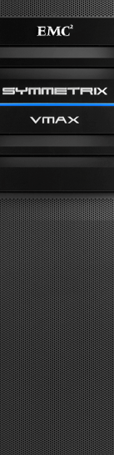
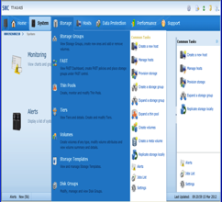
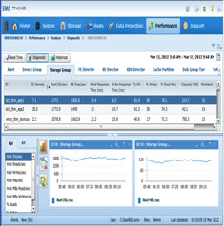
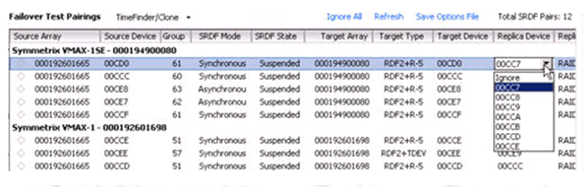
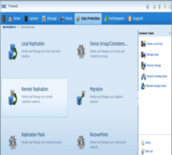
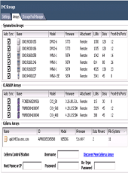
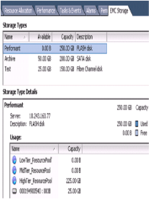

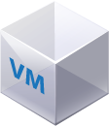

Optimized for VMware Environments
vSphere
and VMware
integration
Optimized for VMware
VMAX plug-in to admin through vSphere
Performance Optimized
Almost 700K IOPS
FAST VP
Host offload with VAAI/VASA APIs
Virtual Pools for space-
efficient data stores
SRM for automated recovery
EMC VSI or Unisphere
end-to-end view
Notes:
Symmetrix VMAX 40K, 20K, and 10K are the best storage arrays for virtual server environments, either VMware and Microsoft Hyper-V, bringing both smart and powerful functionality to these environments. This graphic outlines the VMWare integration and the next slide will go into detail on integration with Microsoft’s Hyper-V.
EMC’s Enginuity Operating Environment delivers integration with VMware vSphere 5.x with support for vStorage APIs for Array Integration (VAAI). VAAI includes a set of key APIs that intelligently offload storage hardware acceleration functions to the storage array. This increases scalability by enabling 10-times less I/O for formatting commands, with 10-times more virtual machines per data storage, and 10-times faster replication of virtual machines to create snapshots and clones that can be used to speed deployments.
The Symmetrix VMAX family is VMware Certified and supports VMware VASA (vSphere Storage APIs for Storage Awareness) and VMware vCenter Site Recovery Manager (SRM). VASA can be used to implement QoS through compliance with storage profile assignments for VMs and their associated ESX datastores (LUNs). VMware SRM is supported by Symmetrix VMAX family, SRDF for VMAX 10K, and RecoverPoint, and simplifies and automates disaster recovery workflows.
Beyond the standard VMware integration, EMC has delivered Virtual Storage Integrator (VSI). With VSI, storage administrators can allow virtual server administrators to have access to storage resources to provision capacity. This allows storage administrators to easily leverage the advanced efficiency, scalability, and security capabilities of Symmetrix VMAX 10K for virtual servers. The key to Virtual Storage Integrator is that the storage administrator continues to maintain control of the infrastructure, and can effectively manage virtual server storage in combination with other applications sharing the same storage array.
EMC ProSphere also provides end-to-end visibility of the virtual environment and automated management for mixed storage environments with the following functionality:
End-to-end visibility and control for a single management screen
Discover, visualize, and manage storage-to-virtual machine relationships
Simplify the ability to monitor, provision, and report on virtual servers

Slide 34
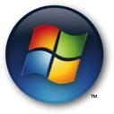
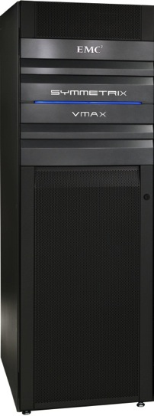
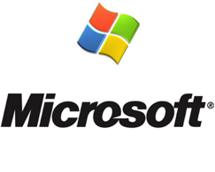
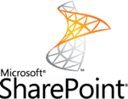
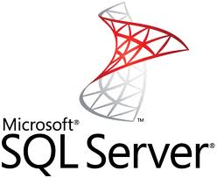


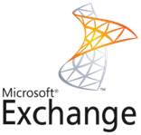
Symmetrix VMAX 10K and Microsoft
Hyper-V Integration
EMC Storage Integrator for Windows
Application-aware storage provisioning for Windows and Hyper-V environments
EMC Storage Integrator simplifies:
  Provisioning
  Migration
  Monitoring
Leverage additional array capabilities
Notes:
EMC Storage Integrator for Windows simplifies the management and provisioning of EMC storage for Microsoft Windows Servers and Applications in a physical as well as virtual(Hyper-V) environments. It maps application resources to Windows and in turn provides mapping to underlying Storage resources.
With Storage Integrator, administrators can provision block and file storage for Microsoft Windows and Microsoft SharePoint Farms. Storage Integrator supports the EMC CLARiiON CX4 series, EMC VNX series, EMC VNXe series, and the entire Symmetrix VMAX family. EMC’s latest version, 1.3, adds virtualization capability using Hyper-V and support for File Stream Remote Blob Store.
EMC Storage Integrator for Windows allows:
Application-aware Storage Provisioning for Windows and Hyper-V environments
Modular approach for release and development flexibility
Ease of provisioning in coordination with Element Manager directions for EMC platforms

Slide 35



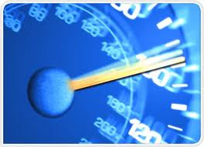

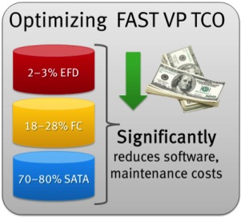
VMAX 10K for Microsoft SQL Server
Leveraging FAST VP technology
Virtual Server
Virtual Server
Virtual Server
FAST VP and Microsoft SQL
  Up to 40% higher performance
  40% lower storage cost
Why FAST VP for SQL 2012?
  More than 1,000 Symmetrix systems running FAST VP
  Leverages speed of enterprise Flash drives and saves cost with SATA
SQL Server
SQL Server
SharePoint
FC
Notes:
In 2009, EMC announced its vision and strategy of Fully Automated Storage Tiering (FAST). FAST is automation software that puts the right data to the right place at the right time. When EMC delivered the first version of FAST, companies were able to realize significant cost, energy, and floor space benefits. Now, FAST VP is even more superior in delivering greater efficiency and performance. It uses simplified policies to manage virtual storage pools and does this with built-in automation and intelligence.
With EMC automated management, Microsoft SQL workloads gain performance benefits of higher performing drive tiers when necessary; it can also relocate storage to more cost-effective storage tiers when application access is not required, or has been reduced due to dataset aging.
For the past three years, EMC has made this FAST VP a priority in its advanced development labs. With more than 30 PhDs working with hundreds of customers, EMC analyzed over 4,000 of its customers’ applications’ access to information. EMC has further analyzed almost one million volumes of information in more than 2 PB of customer statistics and analyzed over 54 billion I/O transactions.
With FAST VP, the Symmetrix VMAX 10K helps organizations save money and resources.
In the past, 100 TB of storage would require over 1,000 high-speed Fibre Channel disk drives. Now with FAST VP running on Symmetrix VMAX 10K, that same 100 TB requires slightly over 110 disk drives—almost a 90 percent reduction. The FAST VP software intelligently places information based on the application’s usage of storage.

Slide 36

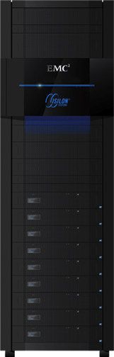
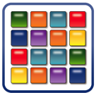
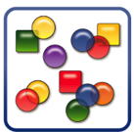

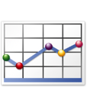







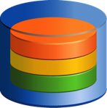




Solution Example: Online Auction House
Mission-critical transactions and high-quality image delivery
Transactions
Analysis
Image
Repository
Structured
Unstructured
Operational Data and
Analysis
Transactions
Image
Store
High Quality
Images
Indexing and
Analytics
www
Mission-critical
Big Data for rich media
Performance
QoS
Scalability
Notes:
This solution demonstrates an example of how a Symmetrix VMAX 10K combined with Microsoft SQL and an EMC Isilon in a Big Data mission-critical online auction application.
Note to Presenter: Click now in Slide Show Mode for animation.
The application is a real-time online auction. The Symmetrix VMAX 10K manages all the structured data (item metadata) as well as responsible for processes all the indexing and data analytics reporting.
Note to Presenter: Click now in Slide Show Mode for animation.
Upon buyer request, the Isilon serves up the images of the products up for auction on the site. Images are served up on demand over the 10 GbE connection to the web servers delivering the images across the Internet to the bidder/buyer.
For “hot” auction items, the online bidding system is able to quickly adapt to high-activity auctions utilizing EMC’s FAST VP technology. FAST VP was designed to react quickly by moving small chunks of data up and down the tiers quicker and more effectively than other automated tiered storage solutions. FAST VP automatically adjusts the SQL database for “hot” bidding items and moves that content into flash for quick user response time. As the end of the auction comes closer, FAST VP is able to quickly respond to interactive bidding and keep the auction fair for all online bidders.
By combining VMAX 10K with FAST VP technology, Microsoft SQL 2012, and EMC Isilon, this online auction house has built a high-availability infrastructure that can respond to the demands of the business.

